Slide 1


DIALYSIS OF PATIENTS
DOMAIN : HEALTHCARE
GROUP : 5
Group Members 1. Vaishnavi Adke 2. Haripriya Santhanam 3. Vishal Bhil 4. Chethan 5. Rushikesh Panchal 6. Goutham Kumar

Slide 2
INTRODUCTION
The "Dialysis of Patients" project in the healthcare domain aims to comprehensively analyze and visualize key performance indicators (KPIs) related to dialysis facilities. This project utilizes two datasets, namely "Dialysis 1" and "Dialysis 2," each providing unique perspectives on dialysis facilities' performance. The KPIs have been explored and visualized using various tools such as Excel, Tableau, SQL, and Power BI to provide a comprehensive and insightful dashboard
Healthcare Domain Overview:
The healthcare domain stands as a critical pillar of societal well-being, dedicated to the provision of medical services, preventive care, and the continuous improvement of patient outcomes.
Project Name: Dialysis of Patients
The "Dialysis of Patients" project within the healthcare domain focuses specifically on the realm of dialysis facilities and the outcomes of patients undergoing dialysis treatment.
In an era of technological advancements, data-driven decision-making has become instrumental in optimizing healthcare delivery, ensuring patient safety, and enhancing operational efficiency.
Key stakeholders within this domain include healthcare providers, administrators, policymakers, and, most importantly, patients. The overarching goal is to establish systems and processes that not only treat illnesses but also promote holistic well-being and preventive care.
Dialysis plays a crucial role in managing kidney-related disorders and is a lifeline for individuals with compromised kidney function.
The project aims to shed light on various aspects, ranging from facility characteristics and operational statistics to patient outcomes and financial considerations.
By analyzing key performance indicators (KPIs) derived from datasets, the project seeks to provide actionable insights that can influence decision-making, improve patient care, and contribute to the overall optimization of dialysis facilities.

Slide 3
Datasets Overview :
This dataset provides a detailed overview of dialysis facilities, encompassing critical information such as provider details, facility names, state-wise ratings, patient outcomes, and operational statistics.
Key dimensions include patient transfusions, hypercalcemia incidents, hospitalization rates, survival rates, and infection occurrences.
Facility characteristics such as profit status, chain ownership, and the number of dialysis stations are also examined.
Dialysis-2 Dataset:
This supplementary dataset adds depth to the analysis by incorporating specific metrics related to individual dialysis centers.
Metrics include VATCatheter, VATFistula, NKt/VComprehensive, Hypercalcemia, NHSNBSI, and an overall Total Performance Score.
Additionally, the dataset includes payment reduction percentages for the year 2020, offering insights into the financial landscape of these facilities.
Dialysis-1 Dataset:

Slide 4
Key Performance Indicators (KPIs) Explored:
Number of Patients across Various Summaries :
Analyzes the distribution of patients across different summaries, providing insights into the facility's overall patient-related metrics.
Profit vs. Non-Profit Stats :
Explores the distribution and performance statistics of profit and non-profit dialysis facilities, shedding light on potential differences in outcomes and operations.
Chain Organizations with Total Performance Score as No Score :
Investigates the relationship between chain-owned organizations and total performance scores, identifying facilities with no score and potential areas for improvement.
Dialysis Stations Stats :
Provides an overview of the distribution of dialysis stations, categorizing facilities into low, medium, and high capacity based on the number of stations.
# of Category Text - As Expected :
Analyzes the frequency of occurrences of the "As Expected" category text across various metrics, offering insights into areas where facilities meet or exceed expectations.
Average Payment Reduction Rate :
Calculates the average payment reduction rate for dialysis facilities, contributing to financial insights and potential areas for cost optimization.

Slide 5
Tools Used :
Excel:
Utilized for initial data exploration, cleaning, and basic analysis. Excel charts and pivot tables were created to visualize KPIs.
Tableau:
Employed for creating interactive and visually appealing dashboards. Various charts, including bar charts, funnel charts, and maps, were utilized to present KPIs effectively.
SQL:
Executed for data manipulation, filtering, and aggregation to derive key metrics. SQL queries were essential for preparing datasets for visualization.
Power BI:
Utilized for creating dynamic and interactive dashboards. Power BI allowed for seamless integration of multiple data sources and the creation of visually appealing reports.

Slide 6
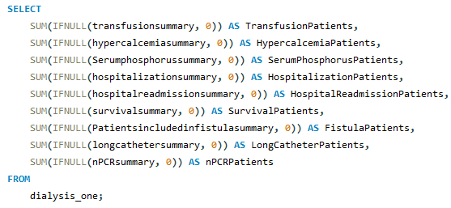

KPI1 : Number of Patients across various summaries
Observations:
The code is using aggregate functions to sum the counts of patients across different summaries for each category.
It is showing the counts of patients related to transfusions, hypercalcemia, serum phosphorus, hospitalization, hospital readmissions, survival, fistulas, long catheters, and nPCR.
Suggestions:
Ensure that the data in the specified columns (transfusionsummary, hypercalcemiasummary, etc.) is appropriately formatted and contains numeric values. If there are non-numeric or missing values, the IFNULL function might be assigning 0, and you may need to handle such cases accordingly.
Consider adding a WHERE clause to filter the data based on specific conditions if needed. For example, you might want to include only certain facilities or providers in your analysis.
Verify the accuracy of the column names used in the code to ensure they match the actual column names in your dataset.
Conclusions:
The aggregated counts for each summary provide an overview of the number of patients associated with different medical conditions or events across your dataset.
Higher counts in specific summaries may indicate areas of concern or increased prevalence of certain conditions.
Lower or zero counts in some summaries may suggest that those conditions are less common or not applicable to the dataset.
OUTPUT :

Slide 7
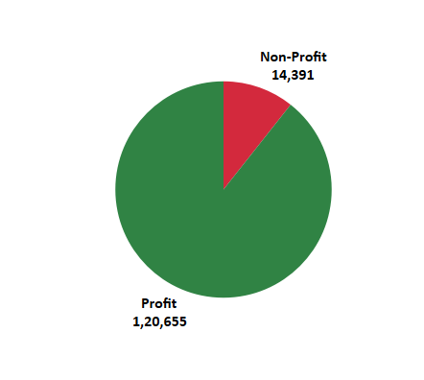
KPI2 : Profit Vs Non-Profit Stats
Observations :
In the pie chart representing the distribution of dialysis stations based on Profit and Non-Profit stats.
A notable majority of the chart is shaded in green (Profit), indicating that a significant proportion of the summation # Dialysis Stations in the dataset is associated with Profit facilities.
The red portion (Non-Profit) is comparatively smaller, suggesting that Non-Profit facilities collectively contribute a smaller share to the summation of # dialysis stations.
This observation implies a potential trend where Profit facilities tend to have a larger aggregate number of dialysis stations compared to Non-Profit facilities in the dataset.
Suggestions :
Ensure that the "ProfitorNonProfit" column has consistent and accurate values (e.g., "Profit" and "Non-Profit"). Verify that there are no misspellings or variations in the naming convention.
Validate the data in the "# Dialysis Stations" column to ensure it contains numeric values and reflects the expected number of dialysis stations for each facility.
If there are multiple rows for the same facility, decide whether to aggregate or filter the data to avoid double-counting in the sum.
Conclusions :
After creating the pie chart, you can observe the distribution of Profit vs. Non-Profit facilities based on the sum of # Dialysis Stations.
A larger portion of green (Profit) in the pie chart suggests that there are more stations associated with Profit facilities.
A smaller portion of red (Non-Profit) indicates a relatively smaller number of stations associated with Non-Profit facilities.
The pie chart provides a visual representation of the proportion of dialysis stations associated with Profit and Non-Profit facilities.

Slide 8
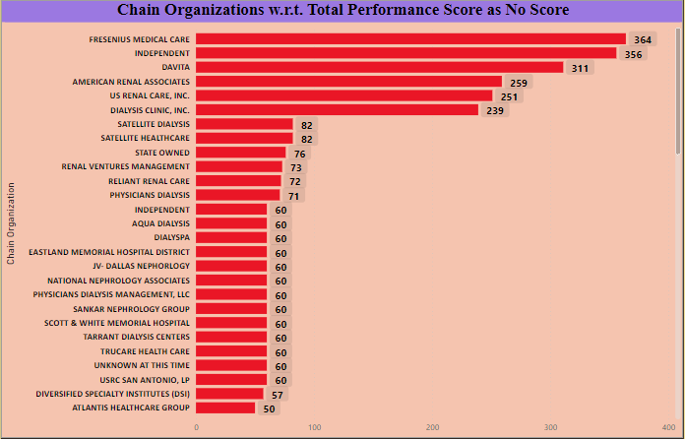
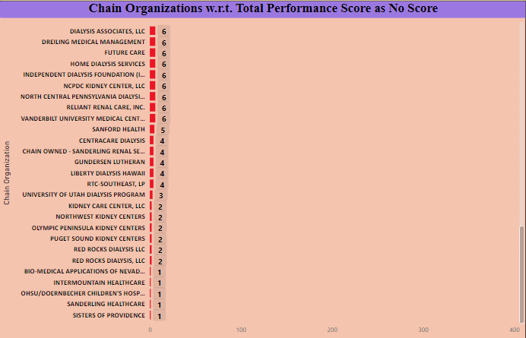
KPI3 : Chain Organizations w.r.t. Total Performance Score as No Score
Observations :
We have data from two datasets: dialysis_one and dialysis_two.
Chain Organizations and their Total Performance Scores (specifically when the score is labeled as "No Score").
The datasets include information about different dialysis facilities, their characteristics, and performance metrics.
Where highest is “Fresenius Medical Care” as 364 and lowest are ”Bio-Medical Applications of Nevada,Inc”,”InterMountain Healthcare”, ”OHSU/Doernbecher Children’s Hospital”,”Sanderling Healthcare” and “Sisters Of Providence” as 1.
Suggestions :
Ensure that there is a common key or identifier between the two datasets that can be used to establish a relationship in Power BI. This could be a unique facility identifier or ProviderNumber, for example.
Create dax for Total Performance Score as no score in dialysis_two dataset.
Validate the data in the "Chain Organizations" column to ensure it is clean and accurately reflects whether a facility is part of a chain or not.
Use Power BI's data modeling features to create relationships between the two datasets based on the common key.
Conclusions :
After establishing relationships between the datasets,create a stacked bar chart in Power BI to visualize the distribution of Total Performance Scores (including "No Score") among different Chain Organizations.
A stacked bar chart allows you to see the contribution of each Chain Organization to the overall Total Performance Scores and understand how much of it is categorized as "No Score."
You can draw conclusions about which Chain Organizations are more likely to have a "No Score“and whether there are patterns or trends.

Slide 9
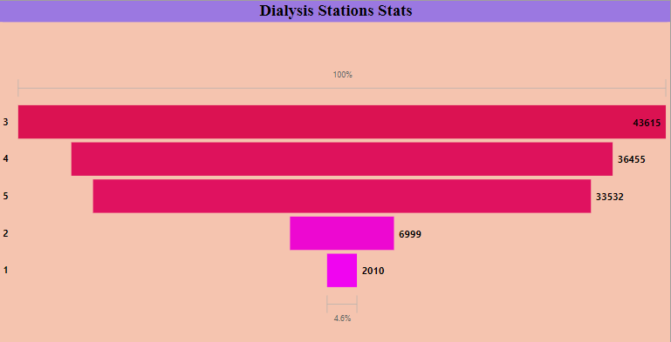
KPI4 : Dialysis Stations Stats
Observations :
The funnel chart visually represents the distribution of dialysis stations across different Five-Star ratings.
The width of each section in the funnel indicates the relative proportion of dialysis stations in each rating category.
It appears that a higher number of dialysis stations are associated with facilities having lower Five-Star ratings, as these sections of the funnel are wider.
Conversely, facilities with higher Five-Star ratings seem to have a relatively lower count of dialysis stations, as indicated by the narrowing sections of the funnel.
Suggestions :
Investigate the factors that contribute to the Five-Star ratings. Are there specific characteristics or performance metrics that lead to higher or lower ratings?
Compare the distribution of dialysis stations across Five-Star ratings in your dataset with industry benchmarks or standards. This can help determine if the observed distribution is typical or if there are areas that need improvement.
Examine the performance metrics of facilities with different Five-Star ratings to understand the correlation between these ratings and overall facility performance.
Conclusions :
The funnel chart provides a clear visualization of how the distribution of dialysis stations varies across different Five-Star ratings.
Facilities with lower Five-Star ratings appear to have a higher concentration of dialysis stations, while higher-rated facilities have a relatively lower count.
Facilities with lower Five-Star ratings may consider focusing on improving performance metrics, patient satisfaction, or other factors that contribute to the rating. This could lead to a more balanced distribution of dialysis stations across different rating categories.

Slide 10


KPI6 : Average Payment Reduction Rate
Observations :
The average payment reduction rate for the specified column (PY2020PaymentReductionPercentage) in the dialysis_two table is 0.32 (rounded to two decimal places).
Suggestions :
Investigate the distribution: Look at the distribution of the PY2020PaymentReductionPercentage values to understand if there are extreme values or if the data is skewed. This can provide additional insights into the overall picture.
Consider additional metrics: Average alone may not provide a complete picture. Explore other statistical measures such as median, standard deviation, or quartiles to gain a more comprehensive understanding of the data.
Conclusions :
The obtained average payment reduction rate (0.32) provides a central tendency measure for the data. It indicates the average percentage reduction in payments based on the PY2020PaymentReductionPercentage column.
Further analysis might be needed to understand the factors contributing to this average rate. For example, you could explore if there are specific groups or categories within the data that have significantly higher or lower payment reduction rates.
Consider comparing the average payment reduction rate with industry benchmarks or historical data to assess whether the observed rate is within an expected range.
OUTPUT :

Slide 11
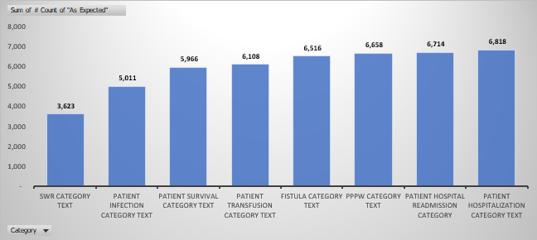
KPI5 : # of Category Text - As Expected
Observations :
The "Patient Infection" category has the highest count among all the categories.
"SWR" and "Patient Transfusion" categories have relatively lower counts compared to others.
The total count of all categories is 47,414.
Suggestions :
Investigate the reasons behind the high count in the "Patient Infection" category. Are there specific factors contributing to this trend or not.
Examine the categories with lower counts (e.g., "SWR" and "Patient Transfusion") to understand if there are any issues or if these are expected low-frequency events.
Consider looking into the "Grand Total" to get an overall perspective on the distribution of the "As Expected" condition across all categories.
Conclusions :
The high count in the "Patient Infection" category might suggest a need for further attention to infection control measures.
Categories with lower counts may be less common or might not be areas of major concern.
The "Grand Total" provides an overview of the total count of occurrences under the "As Expected" condition, giving a comprehensive view of the dataset.

Slide 12
CONCLUSION
Patient-Centric Insights:
The focus on the number of patients across various summaries facilitates a patient-centric approach, allowing healthcare professionals to pinpoint areas of improvement and tailor interventions to enhance patient outcomes.
By understanding the distribution of performance across different categories, healthcare providers can personalize care plans and address specific challenges faced by patients in each category.
Chain Organization Performance:
Analyzing chain organizations with respect to Total Performance Score allows decision-makers to identify high-performing and underperforming chains.
This insight can be instrumental in fostering collaboration and knowledge-sharing among chain-owned dialysis centers, promoting best practices and elevating overall performance.
Financial Implications and Organizational Health:
The Profit Vs Non-Profit Stats shed light on the financial landscape of dialysis centers.
This information is crucial for decision-makers to understand the financial health of the organization.
It helps in strategizing and allocating resources effectively, ensuring that financial sustainability aligns with the mission of providing quality patient care.

Slide 13
Operational Efficiency:
The Dialysis Stations Stats provide insights into the operational capacity of dialysis centers.
Decision-makers can use this information to optimize resource allocation, streamline workflows, and enhance overall operational efficiency.
Understanding the distribution of dialysis stations helps in identifying outliers and addressing capacity-related challenges.
Quality of Care and Compliance:
The # of Category Text - As Expected contributes to assessing the quality of care delivered by identifying areas where performance consistently meets expectations.
This insight is valuable for maintaining compliance with healthcare standards and regulations, ensuring that patients receive care that aligns with expected benchmarks.
Financial Impact on Payment Reduction:
The Average Payment Reduction Rate provides an understanding of the financial implications of performance.
Decision-makers can use this information to assess the effectiveness of cost-saving measures and develop strategies to minimize payment reductions while maintaining high-quality patient care.
The Dialysis of Patients dashboard provides a comprehensive view of key performance indicators, enabling healthcare professionals and decision-makers to identify trends, make informed decisions, and implement improvements in patient care and operational efficiency across dialysis centers.
Regular monitoring and analysis of these KPIs will contribute to better patient outcomes and enhanced organizational performance in the healthcare domain.

Slide 14
THANK YOU

